Slide 1
Brain Age Predictor Subcortical data
Skylar Wurster

Slide 2
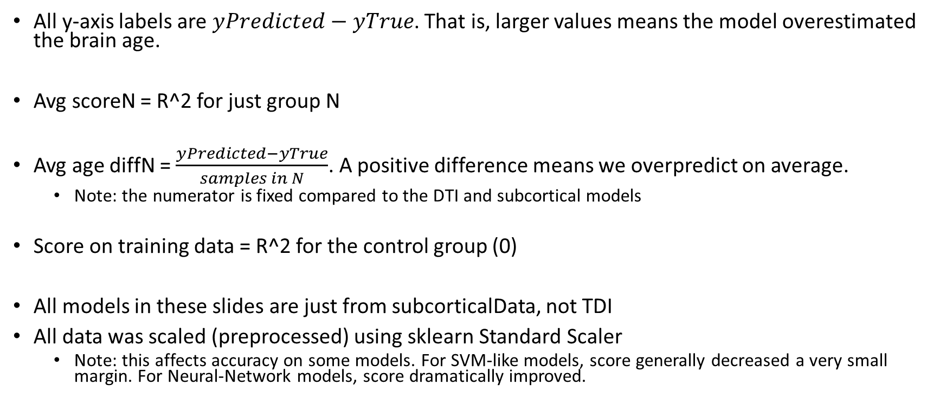
Background and important information
All y-axis labels are $yPredicted−yTrue$. That is, larger values means the model overestimated the brain age.
Avg scoreN = R^2 for just group N
Avg age diffN = $\frac{yPredicted−yTrue}{samples in N}$. A positive difference means we overpredict on average.
Note: the numerator is fixed compared to the DTI and subcortical models
Score on training data = R^2 for the control group (0)
All models in these slides are just from subcorticalData, not TDI
All data was scaled (preprocessed) using sklearn Standard Scaler
Note: this affects accuracy on some models. For SVM-like models, score generally decreased a very small margin. For Neural-Network models, score dramatically improved.

Slide 3
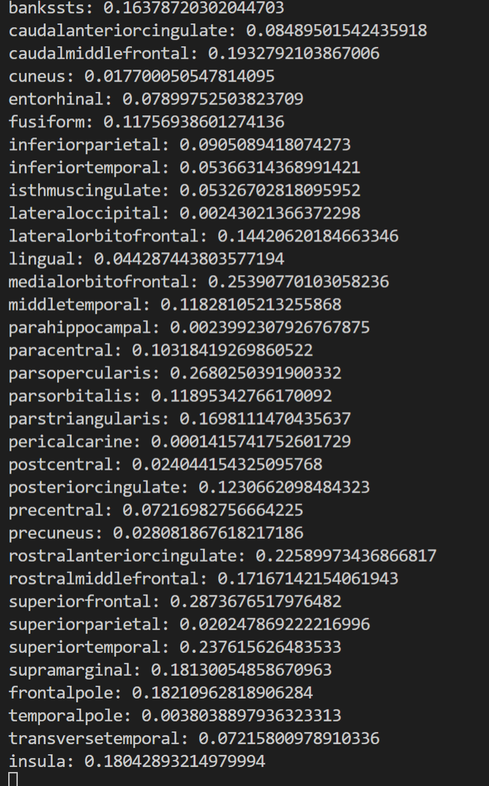
Single variable linear regression
These are the R^2 values for each single variable against age for just the control group
Highest single variable predictive power

Slide 4
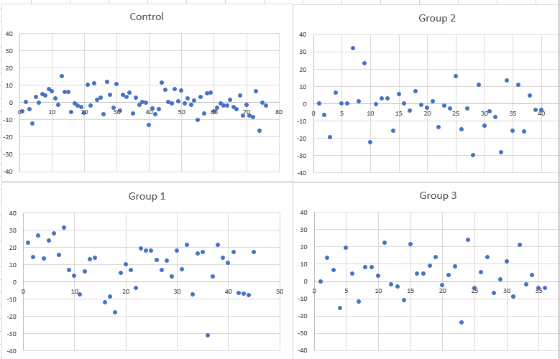
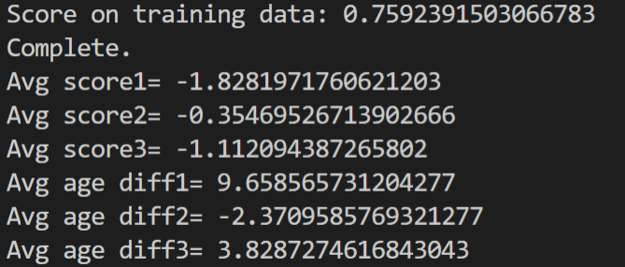
Linear Regression

Slide 5
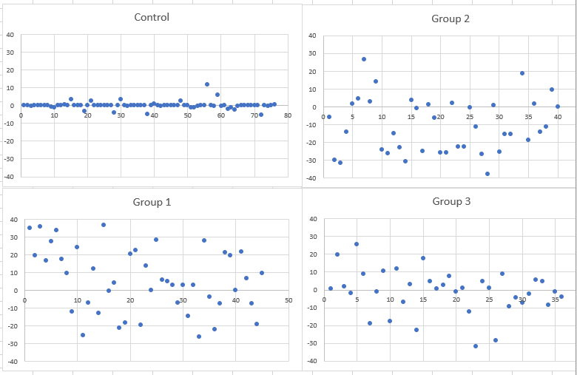
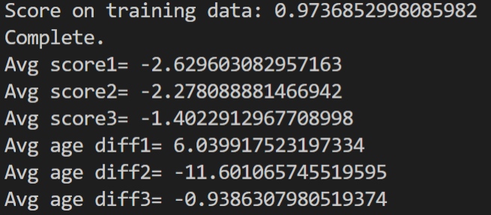
Neural Network (2)

Slide 6
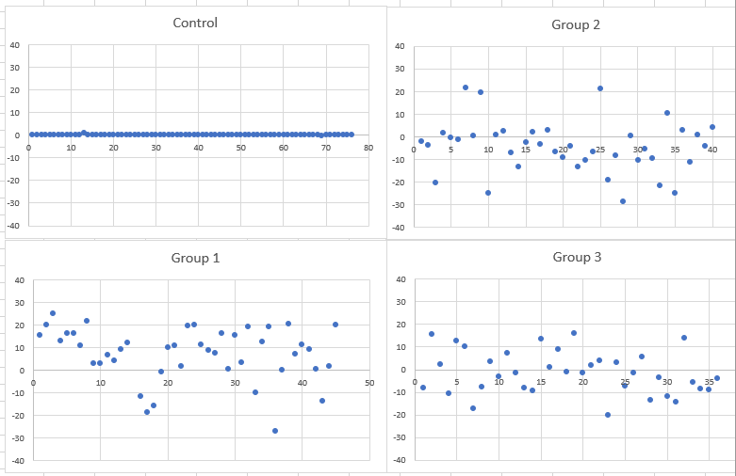
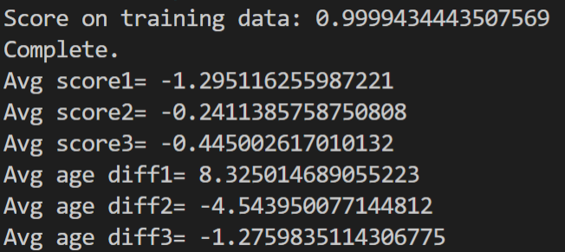
Neural Network (100)

Slide 7
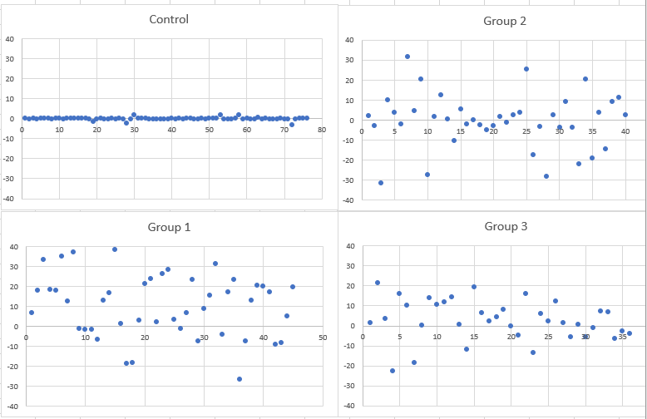
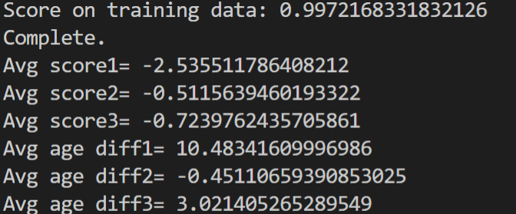
Neural Network (100, 100, 100)

Slide 8
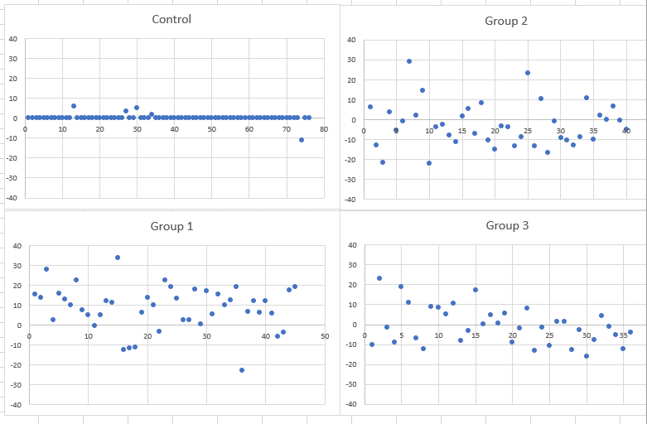
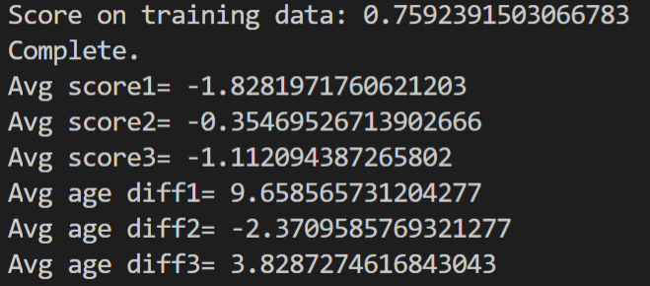
SVM Regressor – RBF Kernel
Gamma=‘scale’
C=50

Slide 9
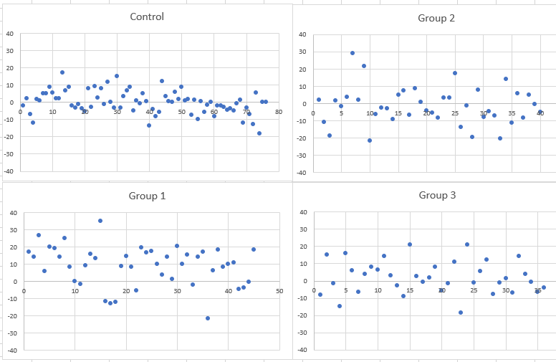
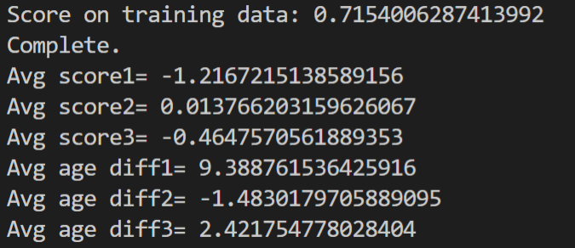
RidgeCV

Slide 10
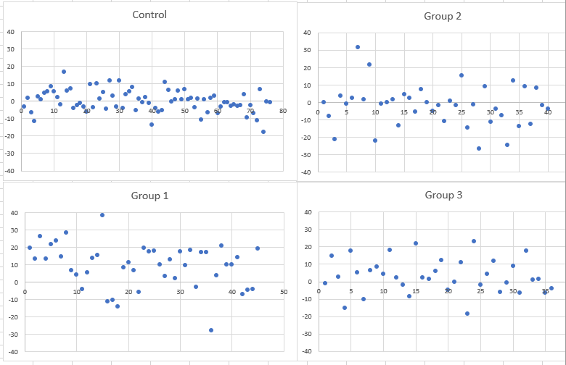
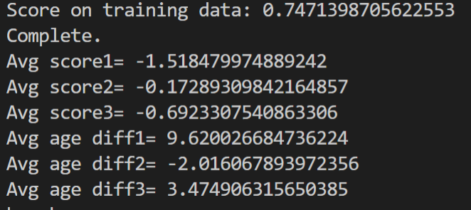
Lasso

Slide 11
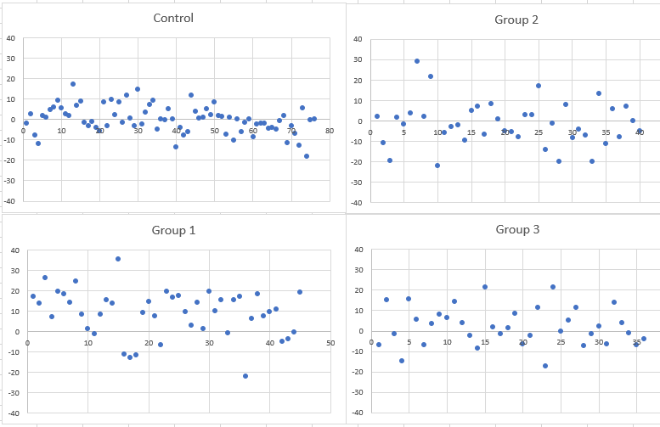
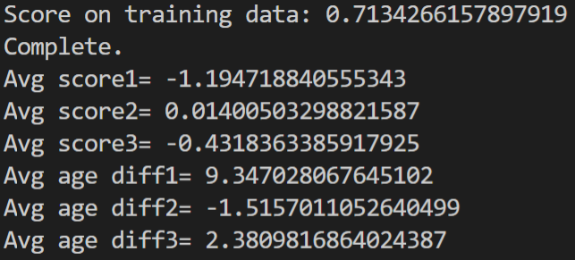
ElasticNetCV

Slide 12
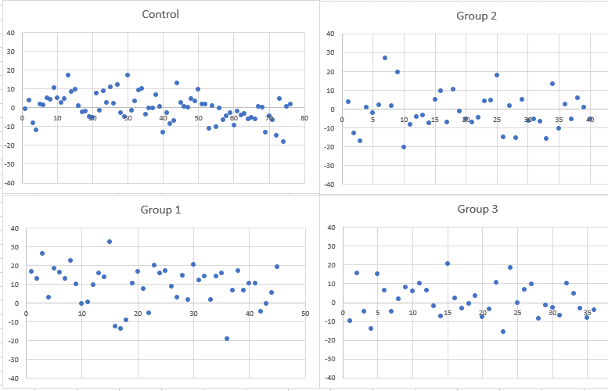
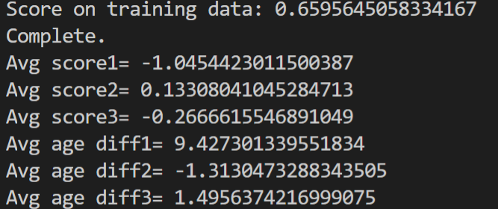
BayesianRidge

Slide 13
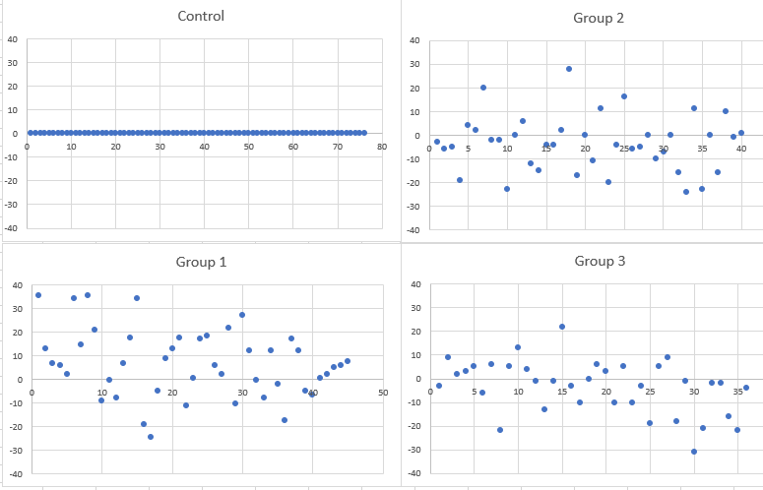
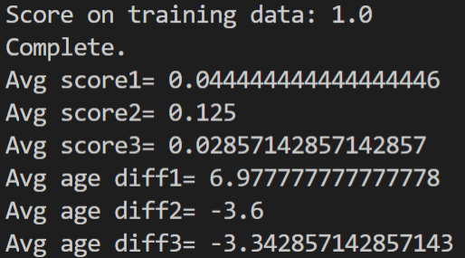
Perceptron(Classifier)
Here, score is simply the accuracy of the classifier

